Slide 1
Week 3/18

Slide 2
Who are Present Today
Kaya, Tyler, Tommy, Matt, Justin, Zach

Slide 3
Overview of Work
Kaya - Worked on controller federate and integrating pandapower
Tyler - Looked into tripping the distribution and transmission system
Tommy - Researched plots and what kind of output types we will need
Matt - Worked with Kaya on pandapower integration with HELICs. Looked into the create_simple pandapower example in order to pin point data extraction that needs to occur between DSSpython and pandapower
Justin - Working with Kaya to get her work on the Docker instances.
Zach -

Slide 4
Kaya - Work
Refactored more code.
Added controller federate. However unsure of what it’s supposed to be doing, and if it’s doing it correctly.
My understanding of what the controller does:
It basically decides when to cut off values. So if you have federate1 sending the values 1-5 to federate2, the controller can decide to cut off the values at 3.
Sender has wait_for_current_time_update in config file, receiver doesn’t. Battery also has this command, but the charger doesn’t, so I’m assuming this means sender correlates to battery and receiver correlates to charger?
Hesitation: In the code for the controller example, there is a comment stating that there is a possible bug in PyHELICS so they had to change the code from how it should theoretically work. Basically applying a bandaid solution.

Slide 5
Kaya - Work
Broker log shows controller isn’t being connected to
Controller doesn’t create a log file.

Slide 6
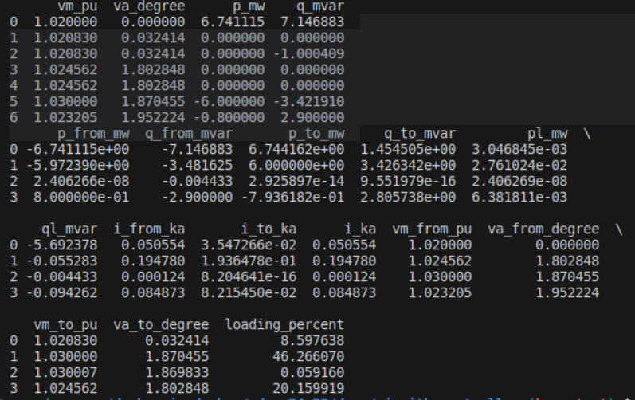
Kaya - Work
Worked with Matt to figure out which pandapower example to use, and what values will need to be sent to dss-python.
Using create.simple

Slide 7
Kaya - Next Steps
Figure out the controller connection issue.
Work with Tommy to get dss-python integrated.
Work with both Tommy and Matt to get the EVs simulated on dss-python.

Slide 8
Tyler - Work
Further looking into documentation on how to trip lines on both the transmission and distribution sides, not really much to report as the research was not very fruitful as of yet.
Helped record and get the presentation ready for class
Did more research/studying for 539 to help me better understand how the grid works and possible ways to cause various outcomes (load shedding, frequency imbalance, etc.)
Future work: More research into documentation and hopefully getting hands on with the working simulation within the coming weeks.

Slide 9
Tommy - Work
Researched various plots and the type of file that could be downloaded
Tried to download plots as a .cvs and was only allowed to download the voltages and not the plots
Is there a way to download the other matplots that are given with the documentation as a .cvs or can I only download the voltage as that?
Talked to Justin and Zach on what would be easier for the frontend
Came to the conclusion on downloading a .SVG plot from the matplotlib and sending it to the frontend
Explored the Master file looking for areas to integrate with panda power
Work in progress, lots of code

Slide 10
Tommy - Future Work
Midterm Individual Review
Work with Matt and Kaya on getting helics implemented with Panda Power and DSS-Python

Slide 11
Matt - Work
Worked with Kaya on the create_simple example from pandapower. Used the net.res_bus and net.res_line to show the voltage at each bus and the current on each line.
Line current and voltages:

Slide 12
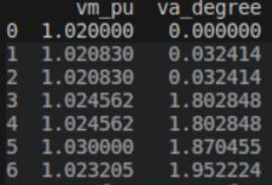
Matt - Work
Bus voltages:
Typology of the network:

Slide 13
Matt - Work
We will need to inject the bus 7 voltage into DSSpython at the interconnection point.
We will also need to send the current at the interconnection point from DSSpython to pandapower and set it as the i_from_kA value for line 4.
Questions:
How do we set a current value for line 4?
Can we set the current of this line to a specified value?

Slide 14
Matt - Future Work
Continue working with Kaya to get pandapower and HELICs implementation
Include Tommy to get implementation with DSSpython for EV load profiles and HELICs

Slide 15
Justin - Work
Tried to get the sender and receiver code that Kaya has been working on to work with the Dockers
Will help with future implementation with the work that Matt and Tommy are doing.
It begins to work with the broker and creates a connection, however the execution stage doesn’t get an error, but never starts. I want to test a few different things with Kaya’s code that will provide insight into what we need to do.
Also worked on more frontend functionality - now the code will not allow a second simulation to be run at the same time. I also added other safety features that stops the app from being destroyed on accident.

Slide 16
Justin - Future Work
The error that is currently occurring is probably small, will redo what I have been doing and attempt to see if it is reproducible or if I made a small error.
Continue working on Frontend implementations - currently very bare bones, but I want to get things looking a bit nicer before the final presentation.

Slide 17
Meeting Minutes
Overview (4:17-4:18)
Kaya (4:18-4:22)
Tommy (4:22-4:23)
Matt (4:23-4:25)
Justin (4:25-4:27)
(The four above were working together in the TLA and already got each other up to date if the times are short, we were already talking about the project)
Zach (4:27-4:31)
Tyler (4:31-4:40)

Slide 18
Questions
Kaya : How exactly does a controller work? Confused on its exact purpose in the simulation.
Tommy: Is the interpoint between distribution/transmission model the two generators in the sub transmission part of the master.dss?
Matt : How can we set a current level for a bus in pandapower and can we do it in real time?

